Slide 1
Report 1
Parking Guidance System Solution

Slide 2
Table of Contents
Project Information
Introduction
Current Situation
Problem Definition
Proposed Solution

Slide 3
Table of Contents
Feature functions
Advantages and Disadvantages

Slide 4

Project Information
Project name: Parking Guidance System Solution
Project Code: PGSS
Product Type: Internet of Things Application
Start Date: 3-Jan-2017
End Date:

Slide 5
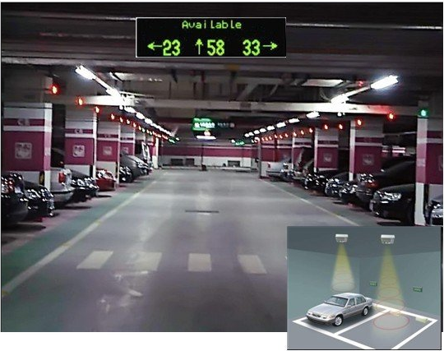
Introduction of Parking Guidance System
A product of the worldwide initiative of intelligent transportation in urban areas
Information and guidance system is designed the monitoring and provision of information on the occupancy of individual parking lots in the parking area.
The system represents a solution to the current problem of a high proportion of a traffic generated by drivers seeking vacant parking spaces.
The guidance system is able to provide drivers with the latest and dynamically chaning information on the availability status of monitored parking lots. Using clear guidance signs, vehicles are guided directly to identified vacant parking lots that are the closest to vehicles’s current positions.

Slide 6

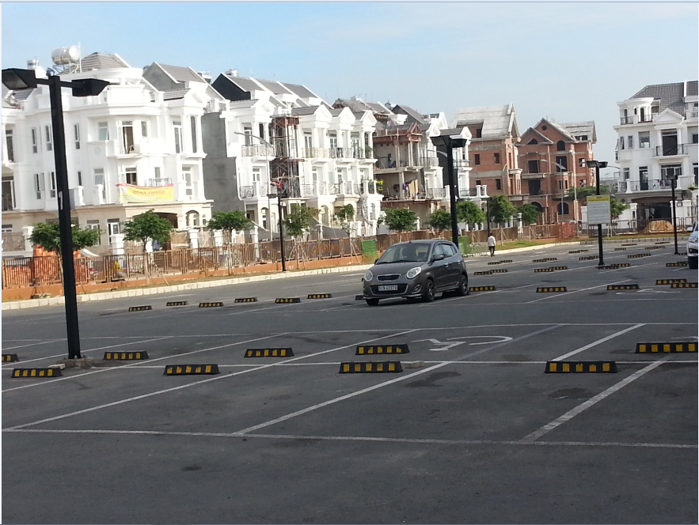
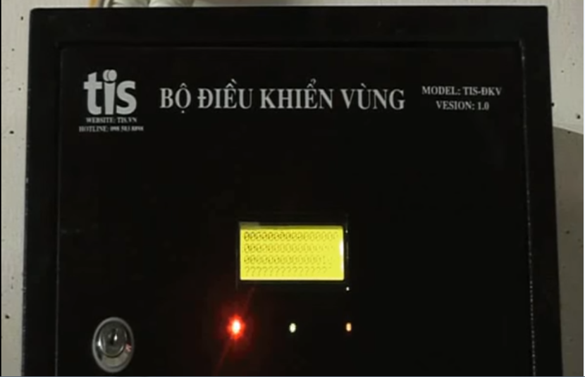
Current Situation
Indoor parking area
Outdoor parking area
Traditional PGS
Growing fast with the increasing number of vehicles
An alternative approach to provide vehicle’s parking lot
A wired system utilize the RS-485 standard.

Slide 7
Problem Definition
Issues, flaws, disadvantages of current system
01
Limited number of monitored parking lots
03
Incompatible with outdoor system
02
Complicated planning of wired system
04
Limited information provided to drivers

Slide 8
Proposed Solution
A wireless Parking Guidance System utilize RF.
A server to keep track of data and information
A mobile app provides a simple and intuitive geolocation for drivers
Our proposed solution is to build a parking guidance system with RF modules. The RF modules provide wireless communication directly between Central Control Unit and Detectors, Indicator LED, Information LED Displays so there is no need for the Zone Control Units.

Slide 9
Feature Functions
A Mobile Application
Detector using Ultrasonic Sensor
Information LED Displays for Main entrance and internal junction
Reservation Barrier
Indicator LED with RGB

Slide 10
Advantages and Disadvantages
Fast orientation of drivers when seeking vacant parking lots
Minimizing the time needed for finding a vacant parking lot
Improvement of safety, the increase of the traffic effectiveness and efficiency
Decreases of exhaust fumes as well as the negative impact of traffic on the environment
Maximum use of the entire car park capacity
Easy to assemble
System does not provide car find feature
The detector can only detect at the location above it so it can’t detect if there is anything around the corner of parking lot
Management portal does not have web version

